Slide 1
BoomBikes Bike Sharing System Data Analysis
Chellingi satya subramanyam (student)

Slide 2
Problem Statement
A bicycle-sharing system, bike share program, public bicycle scheme, or public bike share (PBS) scheme, is a shared transport service in which bicycles are made available for shared use to individuals on a short-term basis for a price or free.
Boom Bikes, a US bike sharing system faced considerable dip in the business when worldwide pandemic which has now made it difficult for the business to operate.
Now in order to tackle this, the company has decided to form a strategy which will be able to provide better and innovative services to their customers along with keeping a check on the acceleration of their revenue generation.

Slide 3
Objectives of the study and analysis
Prepare a proposal document with every intricate detail and workings of the entire project.
Analyse the data and do an exploratory analysis weighing in various factor.
Process data preparation and cleaning using python libraries.
Build a Linear Regression model using Machine Learning techniques to determine the best fit.
Thereby determining the best strategy for the business

Slide 4
Data Information
Data set is in a csv form.
Data set consists of data of span of 2 years (2018 & 2019)
Data shape = 730 rows and 16 columns
It has size of 56.1Kb
Data columns are: instant', 'dteday', 'season', 'yr', 'mnth', 'holiday', 'weekday', 'workingday', 'weathersit', 'temp', 'atemp', 'hum', 'windspeed’, ‘casual', 'registered', 'cnt'

Slide 5
Tools Used
Jupyter Notebook
Python and Libraries: pandas, matplotlib, seaborn, joblib, NumPy and Scikit-learn.
Machine learning tools

Slide 6
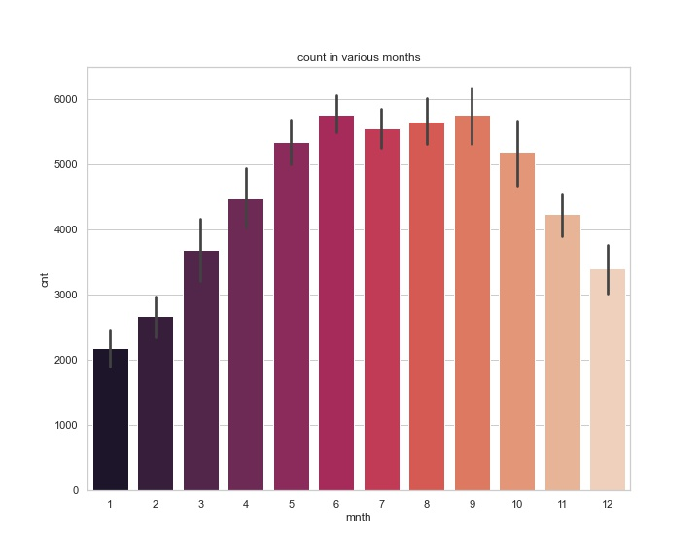
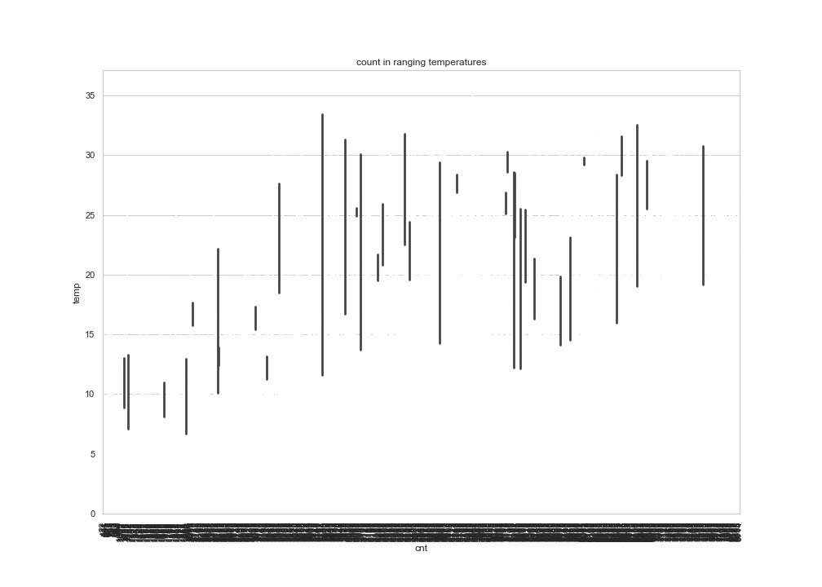
MAXIMUM NUMBER OF BIKES UTILIZED IS IN THE MONTHS OF JUNE AND SEPTEMBER
MAXIMUM NUMBER OF BIKES UTILIZED IS IN HIGHER TEMPERATURES.

Slide 7
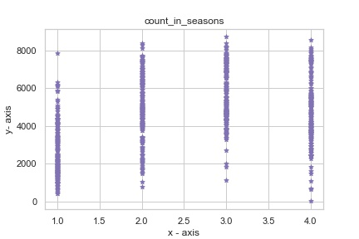
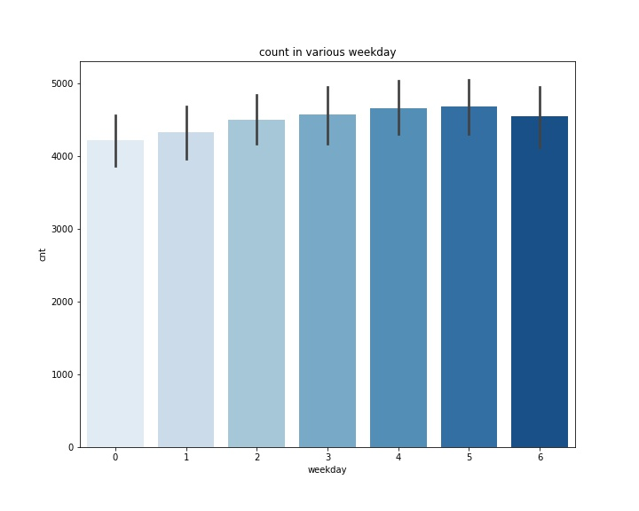
MAXIMUM NUMBER OF BIKES UTILIZED IS IN THE THIRD SEASON
MAXIMUM NUMBER OF BIKES UTILIZED IS ON THE 5TH DAY OF THE WEEK I.E. FRIDAY

Slide 8
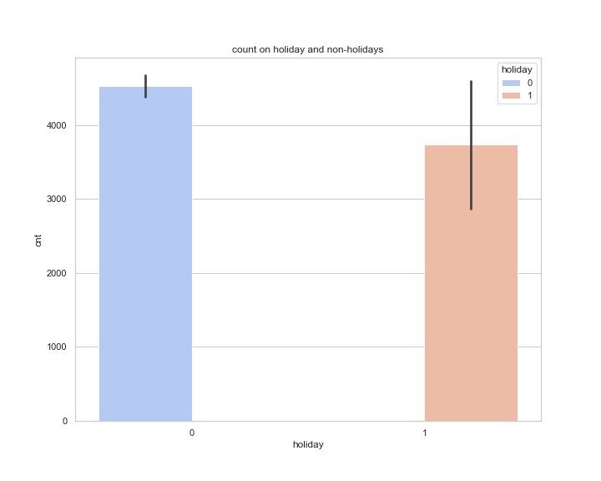
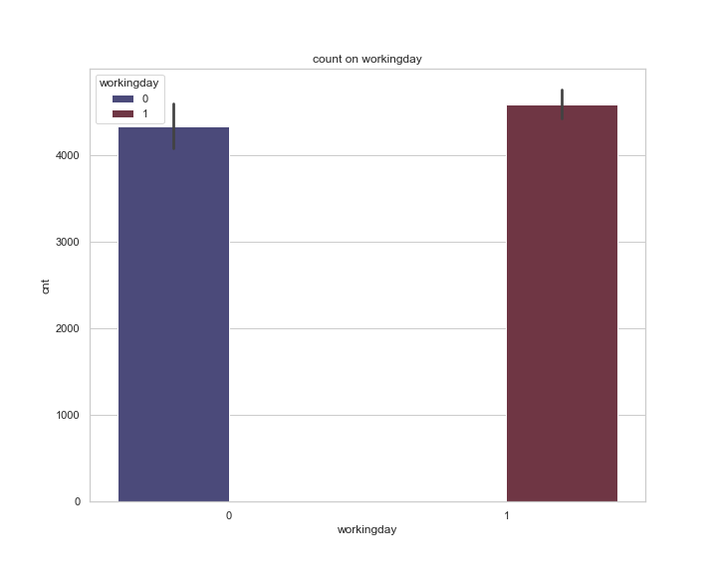
MAXIMUM NUMBER OF BIKES UTILIZED IS ON HOLIDAYS. ALSO THIS DATA HAS IN ALL 21 HOLIDAYS IN 2 YEARS, HENCE MORE BIKES ON HOLIDAYS IS A LOT IN COMPARED TO NON-HOLIDAYS
MAXIMUM NUMBER OF BIKES UTILIZED IS ON WORKING DAYS

Slide 9
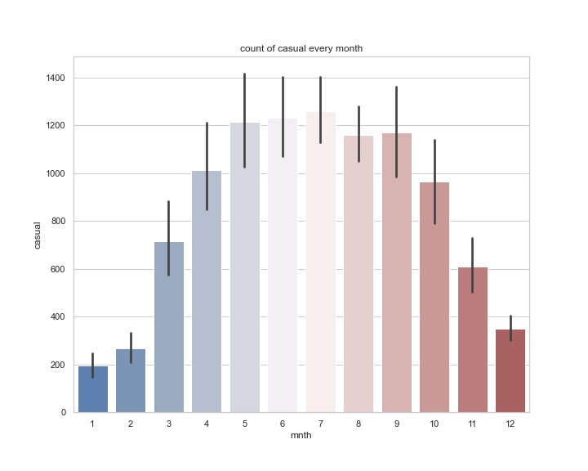
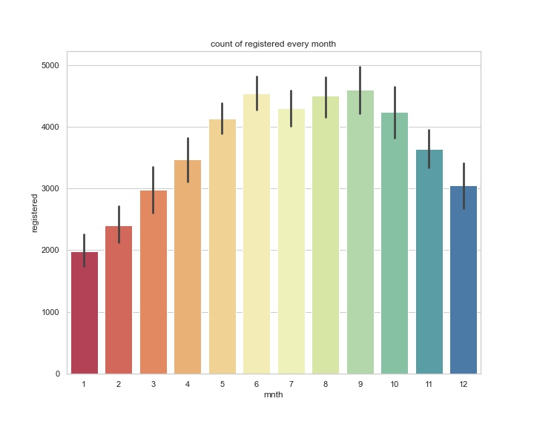
MAXIMUM NUMBER OF CASUAL BIKES UTILIZED IS IN THE MONTH OF JULY
MAXIMUM NUMBER OF REGISTERED BIKES UTILIZED IS IN THE MONTH OF SEPTEMBER

Slide 10
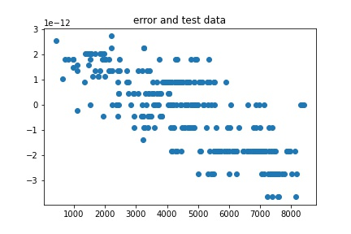

Slide 11
Machine Learning Model
Multiple Linear Regression Model used.
To determine the relationship between dependent and independent variables in data set, in order to know how the count of bikes used varies depending on weekdays, weekends, holidays, temperature month, season, etc.
Independent variables = predictor columns=['season', 'yr', 'mnth', 'holiday', 'weekday','workingday','casual', 'registered’]
Dependent variables = target columns=['cnt’]
Model testing and using mean absolute error, mean square error, Root mean square error and R2 to evaluate the model.

Slide 12
Error Matrices
Mean squared error(MSE)
train data- 1.328763583182056e-12((~0)
Test data-1.2437417914441863e-12 (~0)
Root mean squared error(RMSE)
train data- 2.6385333129628562e-24(~0)
Test data- 2.3370795771593e-24(~0)
Mean absolute error(MAE)
Train data- 1.6243562764870446e-12(~0)
Test data- 1.5287509859880058e-12(~0)
Ordinary least square error/R2
Train data-1
Test data-1

